Slide 1

Advanced Programming and Data Analysis Project
Soad Mohamed 221001449
Manar Abdelmonem 221001939

Slide 2
Contents
Introduction
Methodology
Results
Discussion
Conclusion

Slide 3
Emerging Evidence
COVID-19 is redefined as a multi-organ disease with significant neurological implications
The Intersection of COVID-19 & Alzheimer’s Disease
Bidirectional Relationship
Dementia Patients: Face a higher risk of severe infection.
COVID-19 Survivors: Infection can trigger "brain fog" acting as early-stage neurodegeneration
Shared Pathology
Both conditions share an array of risk factors and pathophysiological mechanisms.

Slide 4
Shared Molecular Mechanisms
Neuroinflammation (Cytokine Storm)
Vascular Dysfunction
Compromises the Blood-Brain Barrier (BBB).
Activates microglia cells, creating a toxic environment similar to chronic AD.
Dysregulation in adrenergic signaling is observed in both conditions.
Protease Imbalance
Disruption in protease inhibitors contributes to plaque formation, linking acute viral response to long-term neurodegeneration.

Slide 5
Project Objective
Primary Aim
Data Integration (NCBI GEO)
identify and visualize Differentially Expressed Genes (DEGs) to establish molecular links between COVID-19 and AD.
GSE188847: COVID-19 Transcriptomic Dataset.
GSE104704: Alzheimer’s Disease Transcriptomic Dataset.
Goal
Establish molecular links via significant biomarkers.

Slide 6
Methodology
Primary Aim
Filtering Criteria
Tools Used: R Programming Environment & GEO2R.
Significant Upregulation: Log2 Fold Change > 1.1
Significant Downregulation: Log2 Fold Change < -1.1
Data Processing
Visualization
Standardization: Aligned Gene IDs and harmonized statistical metrics (Log2FC & P-values).
Integration: Merged datasets into a single analytical framework.
Volcano Plots: To display global gene distribution
Heatmaps: To perform hierarchical clustering of top DEGs

Slide 7
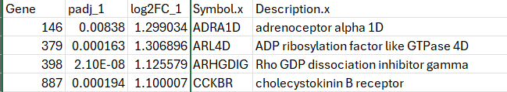
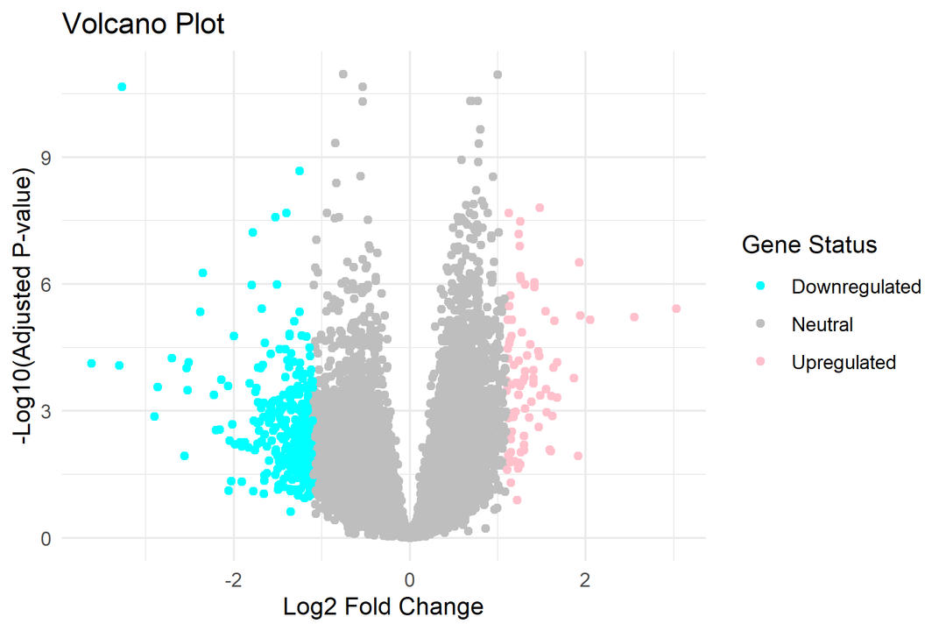

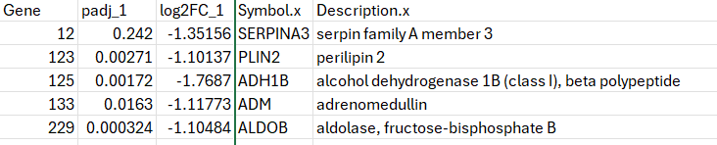
Results
Volcano Plot
Upregulated
Downregulated
The plot shows the genes after the analysis illustrating downregulated genes in blue and up regulated ones in pink.

Slide 8
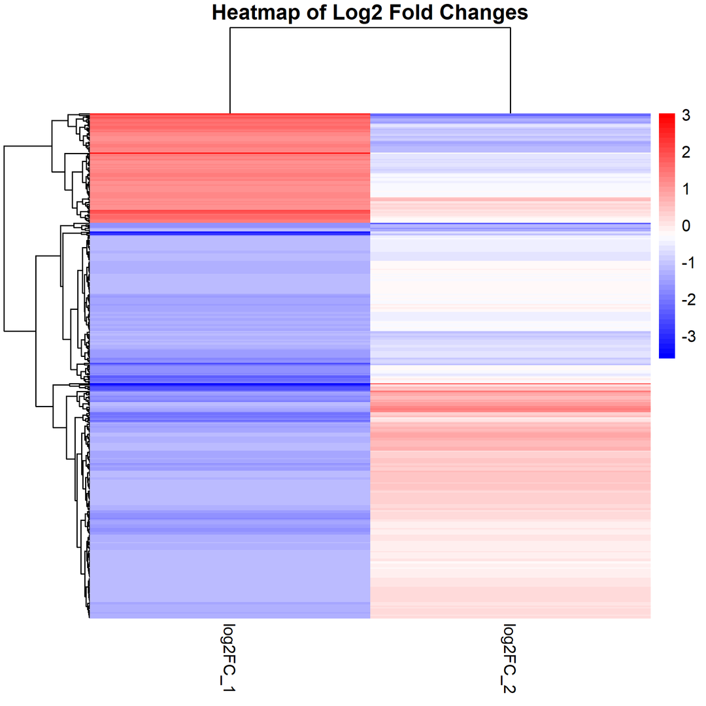
Results
Heat Map
A heat map utilizing a blue-white-red color gradient to visualize expression patterns. Hierarchical clustering separated samples into distinct groups, confirming that this gene set consistently differentiates the experimental conditions.

Slide 9
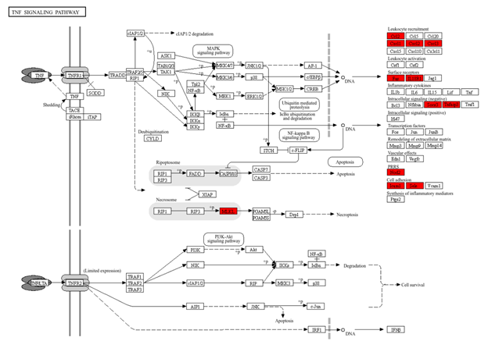
Results
TNF Pathway
Upregulation of Ccl2, Cxcl1, Cxcl2, Cxcl3

Slide 10
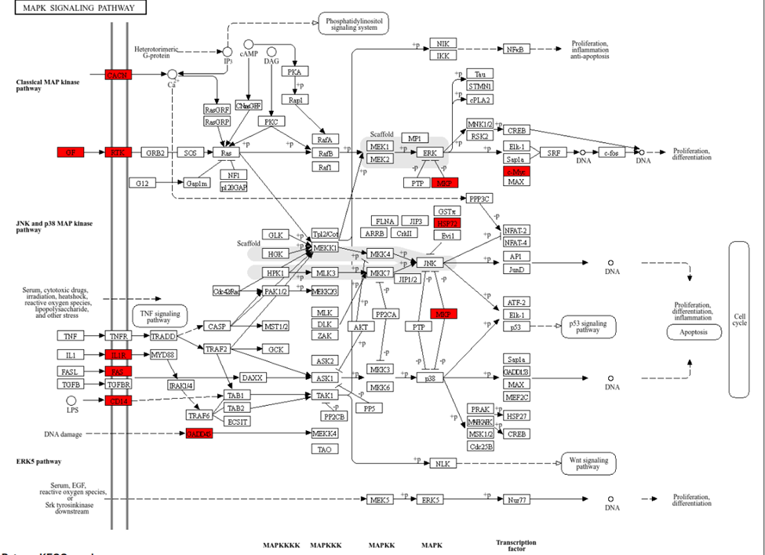
Results
MAPK Pathway
Upregulation of Voltage-dependent calcium channels (CACN),

Slide 11
CACN and ADRA1D Upregulation
CACN is located at the cell membrane open in response to electrical signal to allow calcium to enter.
ADRA1D cells signal to contract
Hyper responsiveness, vasoconstriction, vascular dysfunction

Slide 12
Discussion
Alzheimer's
COVID-19
Calcium Overload: In Alzheimer's, "calcium dysregulation" is a known toxicity mechanism. If CACN channels are overactive, too much calcium enters neurons, leading to cell death (excitotoxicity).
Vascular constriction: In COVID-19, this mechanism explains the vascular damage and clotting risks, as the blood vessels are under constant stress from this calcium-driven contraction.

Slide 13
SERPIN3A and Chemokines
SERPIN3A is a protease inhibitor to prevent proteases from damaging the cell.
Ccl2,Cxcl1,Cxcl1,Cxcl3,Cxcl10 are all signalling for leukocytes at inflammation site.
No SERPIN3A to inhibit proteolytic cascades hence the cell is stuck in an on state recruiting more immune cells

Slide 14
Discussion
Alzheimer's
COVID-19
This mirrors the chronic neuroinflammation seen around amyloid plaques. The brain calls for microglia to clean up plaques (Ccl2 upregulation), but without regulation (SERPINA3), these microglia become toxic and start destroying neurons instead.
"Cytokine Storm." Without the inhibitor (SERPINA3), the immune system over-recruits cells to the lungs or brain, causing severe tissue damage.

Slide 15
Conclusion
This analysis elucidates the shared biomarkers between COVID-19 and Alzheimer’s disease, identifying specific pathway dysregulations that indicate their bidirectional risk. The integration of differential gene expression with pathway enrichment reveals two critical mechanisms including vascular and adrenergic stress. To summarize, these findings provide molecular evidence that SARS-CoV-2 infection increases neurodegenerative risks through specific, identifiable pathways, highlighting ADRA1D and SERPINA3 as potential therapeutic targets to mitigate post-infectious cognitive decline.

Slide 16
Thank
You!

